Slide 1
XG Ratings
by Bob Fearn

Slide 2
An Overview
A weekly calculation analyses everyone’s X-Clubs results for the week just gone by taking into account each player’s:
Previous XG rating
XG ratings of their partners
Strength of their opposition
Variation of scores from benchmarks calculated for each pairing
It updates the XG ratings of over 3000 players of X-Clubs deals
A new ladder gets published on the X-Clubs site each week

Slide 3
Some Background
X-Clubs
A simple concept whereby the same deals are played simultaneously at participating clubs
Ten sessions per week: day-time and night-time deals for each day of the week
Provides the deals, hand-records, travellers for the whole season
Scored across twice daily .. results link to Pianola and Bridge Solver On Line
e-mails, history, trends available gratis from Pianola – Pianola Plus an optional expense
Been going since 2012
Currently 37 clubs involved … 3000+ players
X-Clubs processes the outputs of all common scoring packages
Any club welcome to join .. it’s FREE!!
(.. why wouldn’t your club want to take part?)

Slide 4
Bob Fearn

Slide 5
Bob Fearn
Played in the hey-day of Tokoroa bridge where he first took an interest in calculating movements …
... from which evolved Compass Scoring – Bob’s lifetime labour of love
Moved to Seattle in late 1999 - but seems always to have been on the job
A great, but largely unrecognised, servant of the game of bridge in NZ
If costed at commercial rates, Bob’s contribution would be worth millions … but he’s done it all for free
Containing many helpful peripheries, Compass is much more than just a scoring package
In 2015 Bob extended X-Clubs to score the annual Babich NZ-Wide Pairs
The Babich attracts about 1000 pairs from 60-odd clubs
A recent Friday Daytime X-Club session was scored across 369 pairs from 17 clubs
Daily and weekly results are published on the X-Clubs site – ranked top on searches for “X-Clubs”
(.. why wouldn’t your club want to take part?)

Slide 6
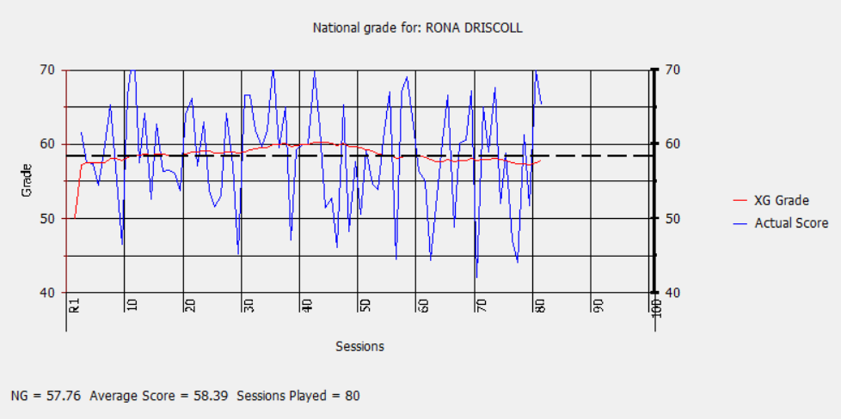
Rona’s XG as at 22nd May

Slide 7
The Methodology
Example: Rona Driscoll’s XG = 57.76% Sharon Opai’s XG = 48.24% The opponents’ average XG = 52.00%
In this session, the “expected score” for the partnership is:
50 plus Average of Rona and Sharon’s current XGs ((57.76 + 48.24) / 2 = 53%)
less Average of the opponents’ XGs (52.00%)
Their expected score will be 50 + 53 - 52 = 51%
If Rona and Sharon scored 57% for the session, the partnership has scored 6% (57 less 51) above expectation thus the recalculated XG for each player will increase.
If Rona and Sharon play in a much stronger field where the oppositions’ average XG is 60%
The “expected score” for their partnership is now 50 + 53 - 60 = 43%
If they scored 47% for the session, the partnership has scored 4% (47 less 43) above expectation thus the recalculated XG for each player increases a little.
As the XG recalculations are dependent on many factors, it is difficult to predict how the XG changes from session to session. However, a rough rule of thumb is that, for every 1% variation from the expected score, the XG will change by 0.025%.

Slide 8
Ratings Systems
The EBU aggregates results presented by their Pay2Play system. The input is a USEBIO file.
Bob applies the publicly-available EBU formula and methodology to X-Club results to get XG ratings
Should NZB develop its own system there is a ready-made dataset in the existing Masterpoint files
It takes a while for XG ratings to stabilise. Three classifications are used:
U = Unpublished for < 150 boards
E = Evolving for 150 to 1000 boards
M = Mature for > 1000 boards
Only the latest 2000 boards – about 80 sessions - are considered
More recent results carry more weighting than older results
XG ratings translate naturally into X-Club Handicapping

Slide 9
… if all NZ clubs joined in X-Clubs …
… we’d have our National Grading System for FREE!!
… except that …
XG’s are based on 40-C club bridge – ie - tournaments, non-X-Clubs deals and Swiss events are not included
XG’s are about as “pure” as a rating system can be – it’s based on the same deals being played simultaneously
Any National Grading System would need an interface for players to go to – the NZB site seems natural
This would entail, undoubtedy, expensive and involved programming work by a third party
Bob has little interest in developing XG’s beyond X-Clubs
but …
He would be happy to help with guidance and consultation if NZB opts to develop an NGS from scratch
.. any questions?
This Photo by Unknown Author is licensed under CC BY-SA

Slide 10
